Slide 1
NHL Database
NIck Rovelli, Quinn Robnett, David Gold

Slide 2
Data Summary
NHL data from the 2023-24 regular season (retrieved from Hockey Reference)
Data includes:
Divisions
Teams
Positions
Players
Games
Team Stats in Games
Player Stats in Games
Goalie Stats

Slide 3
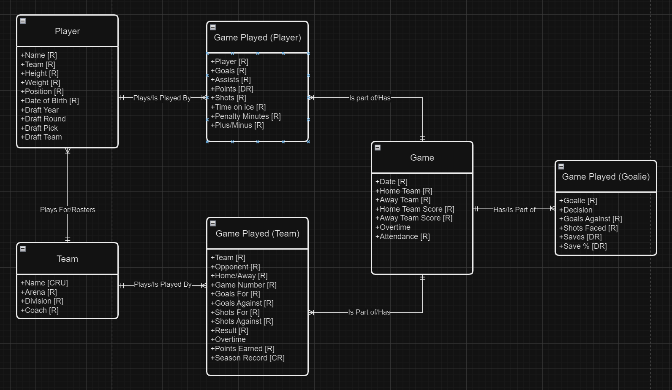
Conceptual Model

Slide 4
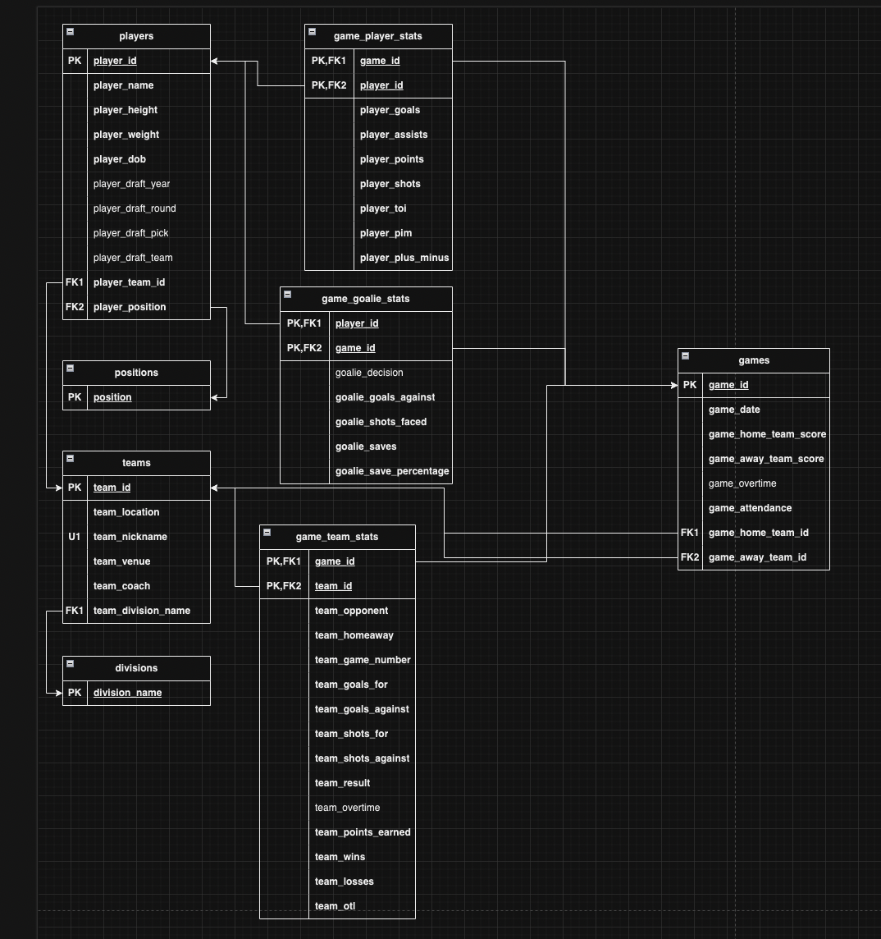
Logical Model

Slide 5
Data Tables with Data

Slide 6
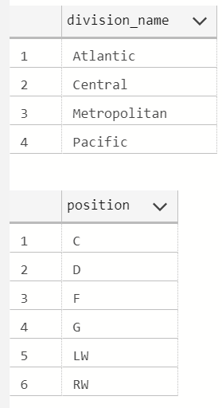
Lookup Tables

Slide 7
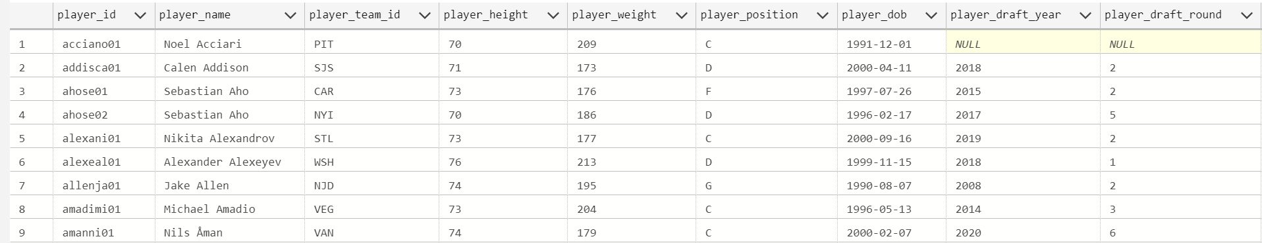
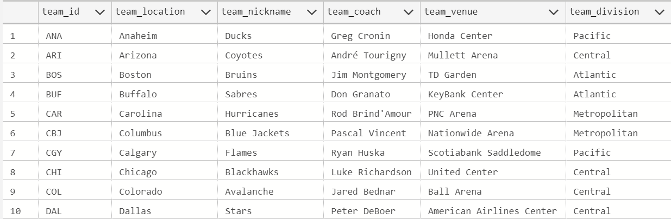
Players and Teams

Slide 8
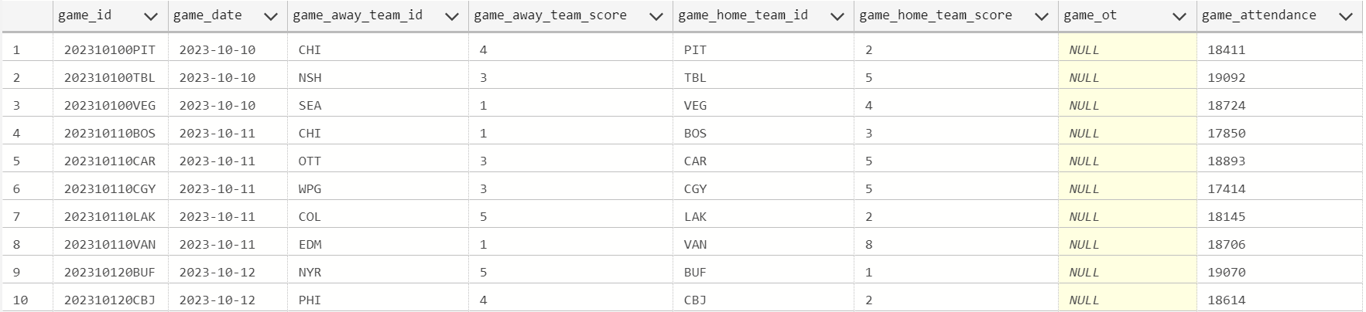
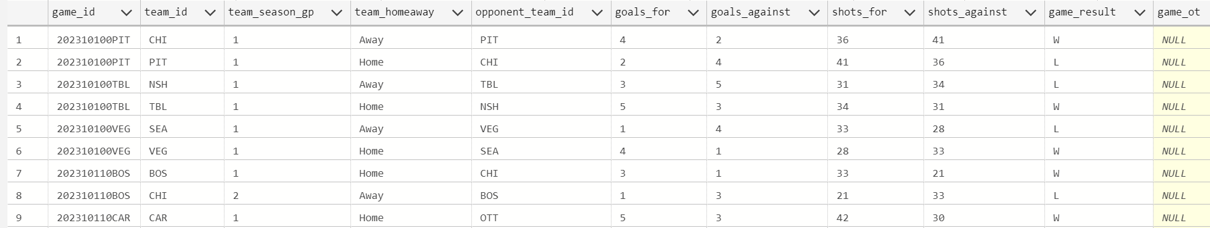
Games and Team Stats

Slide 9
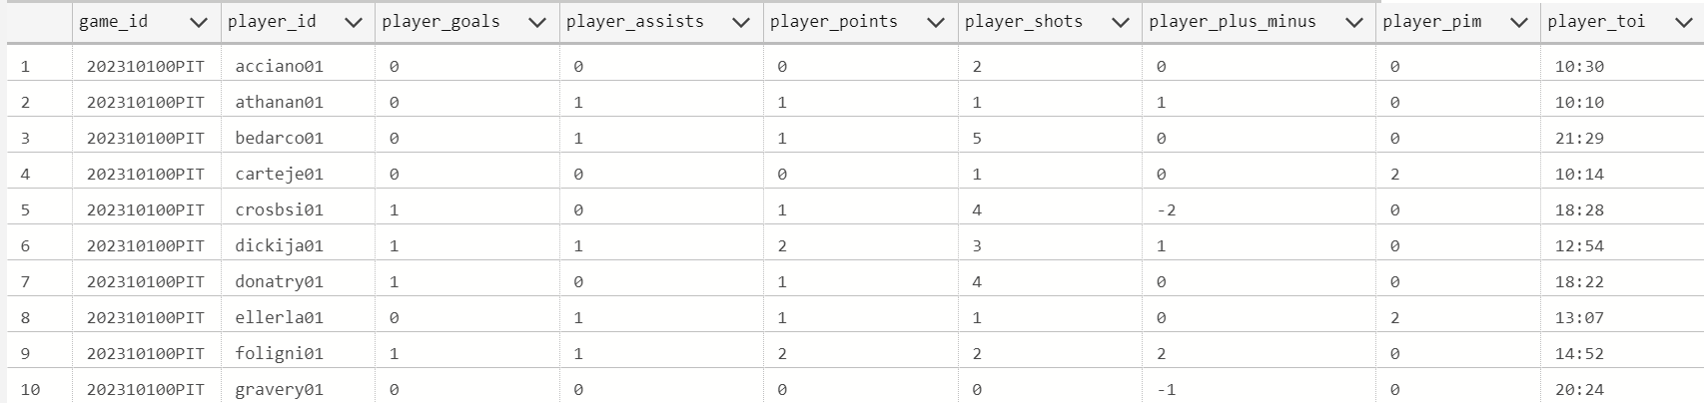
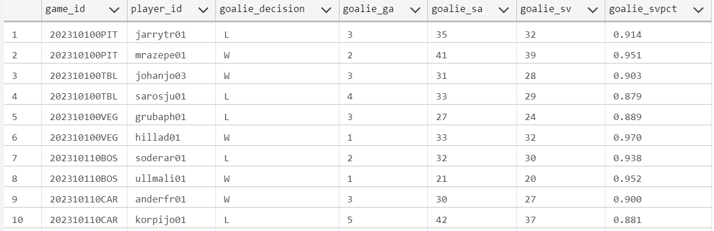
Player and Goalie Stats

Slide 10
User Stories
I can view the current standings in each division to see which teams are likely going to make the playoffs
I can see which players have the most points overall
I can see which positions have the best plus/minus
I can see which teams have the most points by players
I can see all of the above but filtered by player draft year and team division

Slide 11
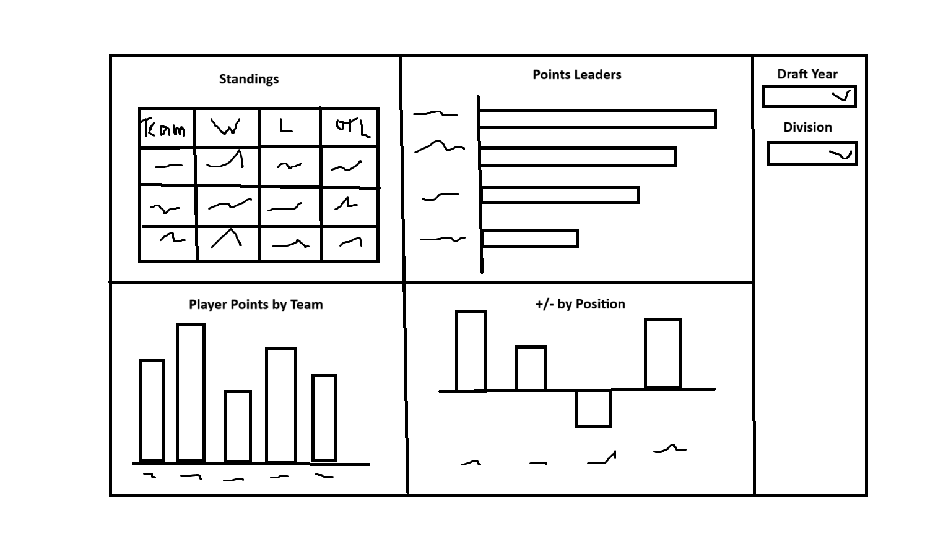
Dashboard Diagram

Slide 12
Dashboard Demo

Slide 13
Thanks!

